Slide 1








Project Name
SnapNotes
Submitted by: Pradeep Singh

Slide 2
Project Overview
Snap Notes is a note-taking application
Designed to help users manage their notes efficiently
Objective: Provide a simple, fast, and reliable way to mange notes.

Slide 3

Technologies Used
01
React
Used React for building dynamic and interactive user interfaces and managing the application's logic efficiently.

Slide 4

Technologies Used
01
React
Used React for building dynamic and interactive user interfaces and managing the application's logic efficiently.
Used for styling the application to ensure it is responsive and visually appealing across various devices.
02
CSS

Slide 5




Key Functionalities
START HERE

Slide 6





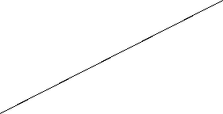
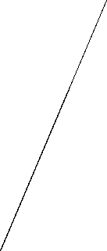
Simple interface for adding new notes
Add Notes

Slide 7

Easy editing of existing notes
Edit Notes

Slide 8

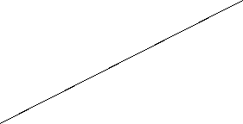
Quick removal of unnecessary notes
Delete Notes

Slide 9
Efficient search functionality to find notes quickly
Search Notes

Slide 10
Ensure notes are saved persistently in local storage
Save Notes

Slide 11
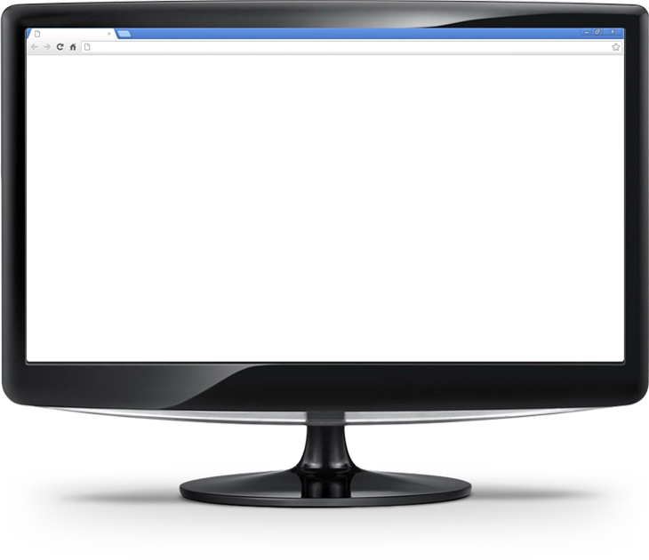
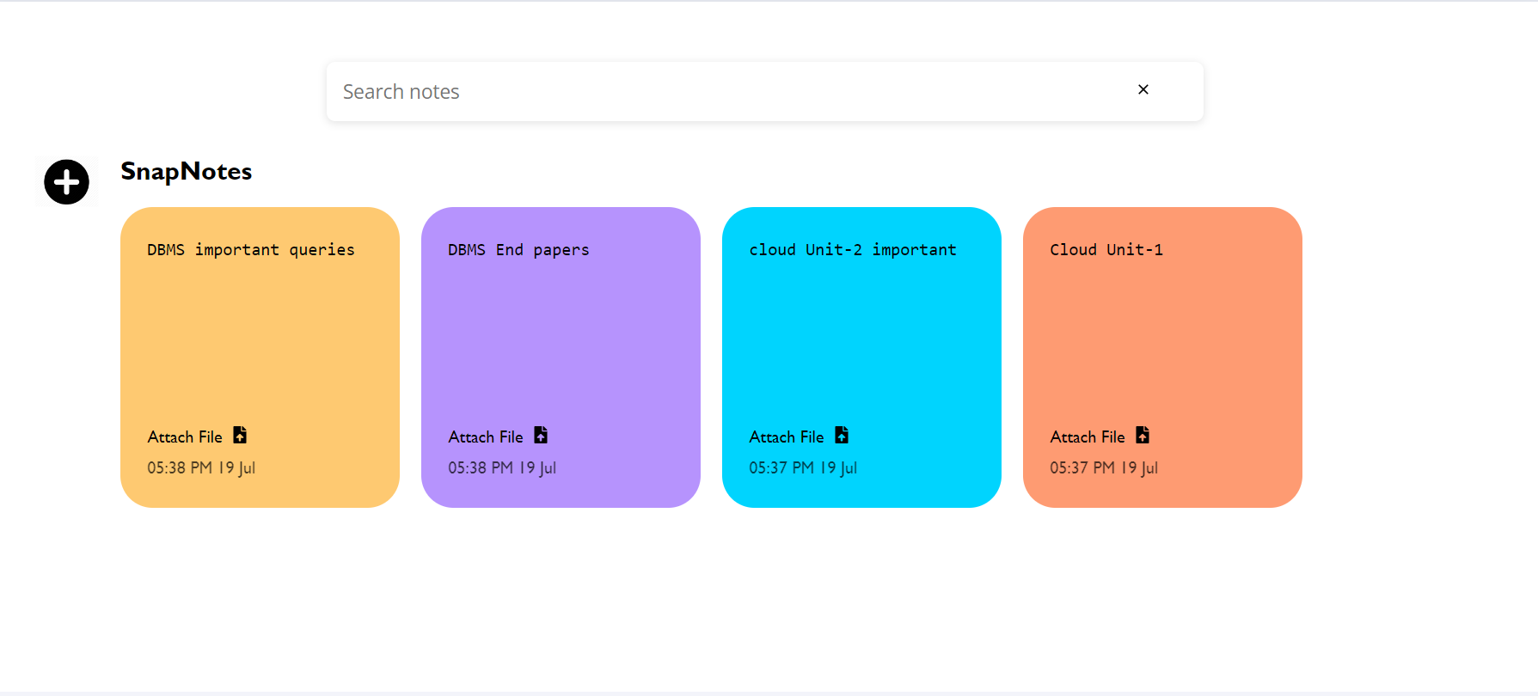

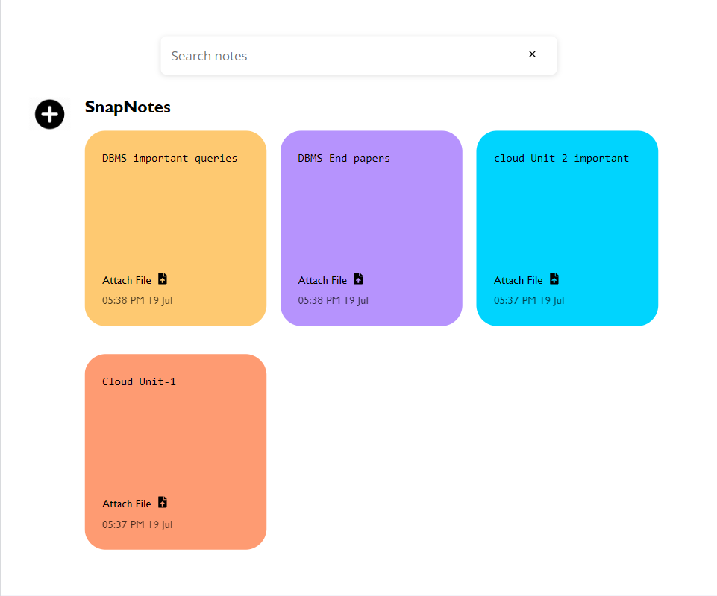
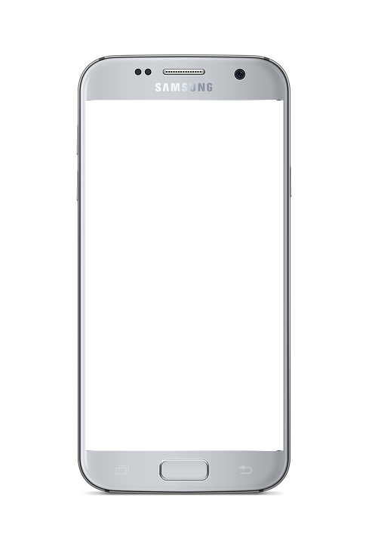
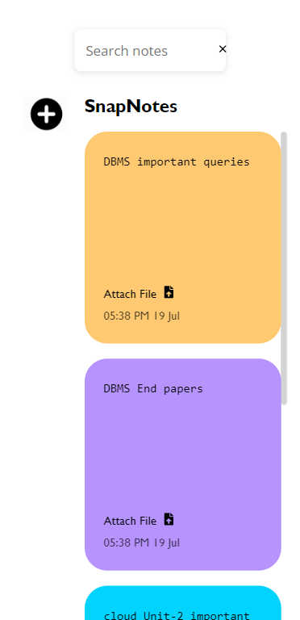
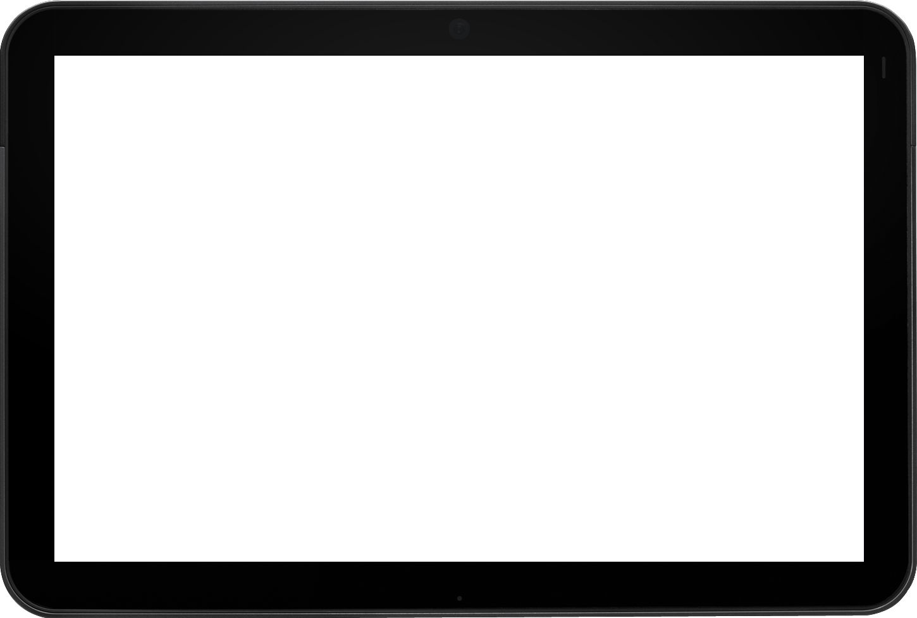
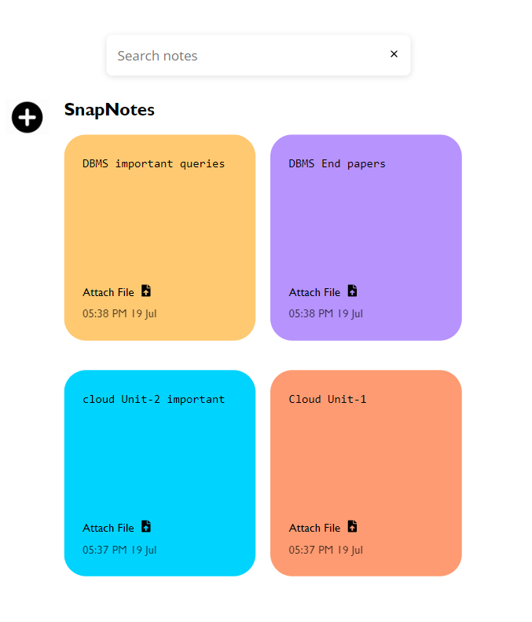
User Interface Design
Design focuses on simplicity and a user-friendly experience.
Responsive Design: Designed to adapt seamlessly to various devices, including desktops, tablets, and smartphones.

Slide 12
Future Enhancements
01
File upload feature
Allow user to attach file to their notes.

Slide 13
Future Enhancements
01
File upload feature
Allow user to attach file to their notes.
Introduce sections or categories for better notes management.
02
Organizational Sections

Slide 14
Future Enhancements
01
File upload feature
Allow user to attach file to their notes.
Introduce sections or categories for better notes management.
Provide advance text formatting options.
02
Organizational Sections
03
Rich Text Editor

Slide 15
THANK YOU

